Slide 1
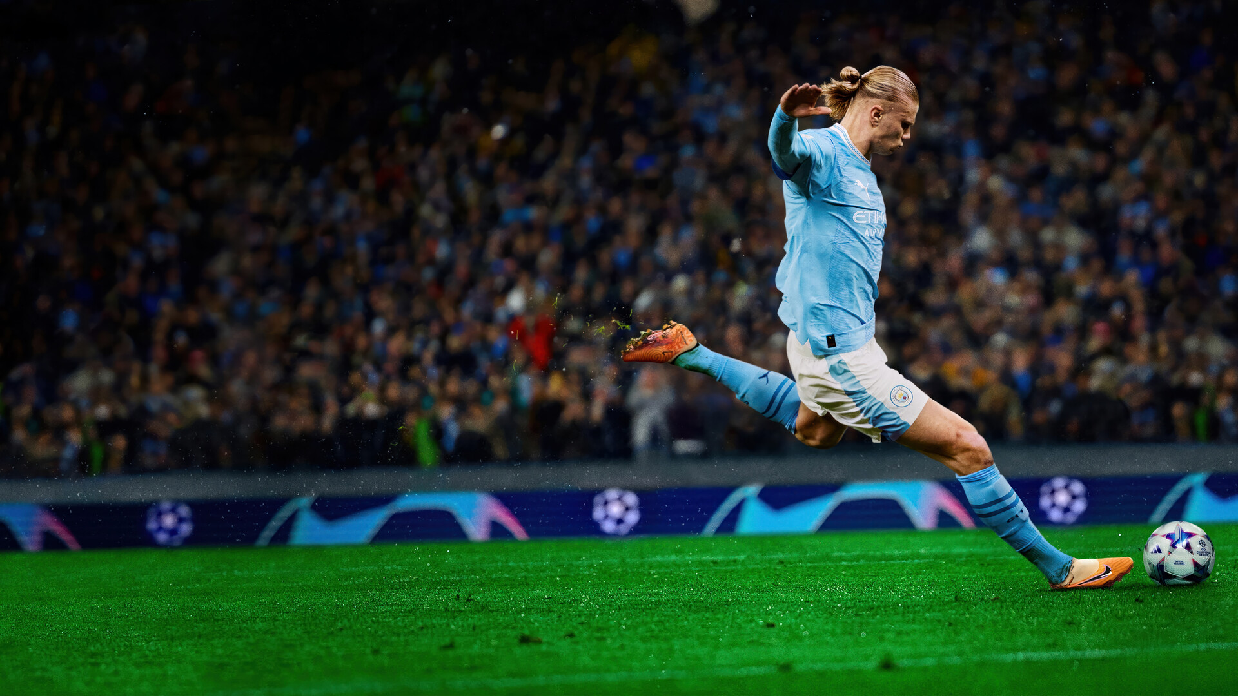
FOOTBALL
LEAGUE
PREDICTION

Slide 2


Our Team
Rohit Singh
Keshav Kumar
Vishakha Kumari
CS Ganapathy
/02

Slide 3
/03
As one of the most popular sports on the planet, football has always been followed very closely by a large number of people.
Predicting match outcomes is a complex challenge due to the many variables influencing results.
This gives an opportunity to apply ML algorithms to predict football match outcomes, using multiple features that include match statistics and attributes of players from both teams.
Introduction

Slide 4
Many techniques to predict the outcome of a football matches have traditionally used the number of goals scored by each team as a base measure for evaluating a team’s performance and estimating future results.
Such techniques often fail to capture key characteristics of players and the dynamics of the game that affects performance and outcomes.
Such techniques often fail to capture key characteristics of players and the dynamics of the game.
Problem Statement
/04

Slide 5
/05
The main objective of this project is to explore different Machine Learning
techniques to predict outcome of football matches, using in-game match events rather than the number of goals scored by each team.
We will explore different model design hypotheses and assess our models’ performance.
Objective

Slide 6
/06
Workflow
01
02
03
04
Data Collection
The data for this project was collected by scraping historical football match statistics from the website FBRef.
Data Exploration
A dataset of 1660 football matches across five seasons, from 2020/2021 to 2024/2025, was collected.
Model Development
Different ML algorithms were
explored to predict outcome of football matches, using team and player statistics.
.
Results
Comparing performance of different ML algorithms with the same set of predictors.

Slide 7
/07
The data for this project was collected by scraping historical football match statistics from the website FBRef. A dataset of 1660 football matches across five seasons, from 2020/2021 to 2024/2025, was collected. However, since only seven games had been played in the ongoing 2024/2025 season at the time of data collection, data from this season was excluded from the analysis.
Data Collection

Slide 8
Out of 1520 matches, the home team won 666 times (20.94%), 340 matches ended in a draw (10.69%), and the away team won 514 times (16.16%).
Among the available variables, an analysis was conducted to determine which were most strongly related to each other, which variables had the highest predictive power for the "goal" attribute, and which could be excluded. To assess the relationships between variables, a correlation matrix was created for all numerical variables
Data Exploration
/08

Slide 9
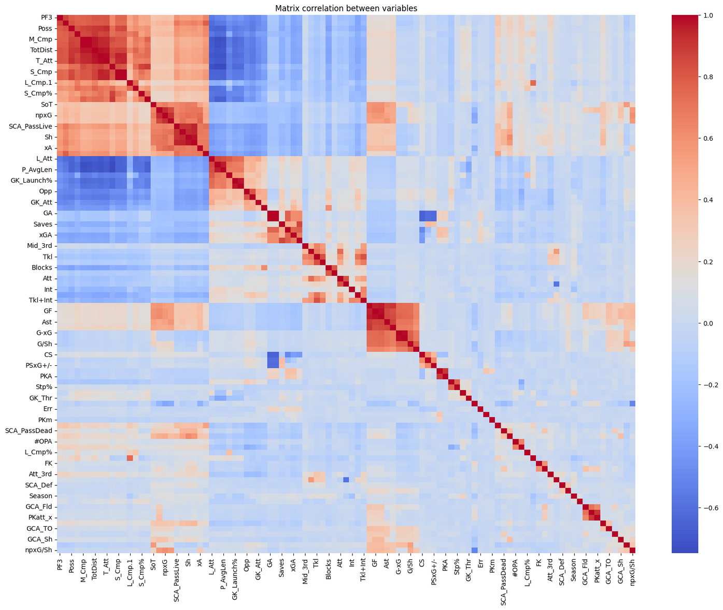

Slide 10
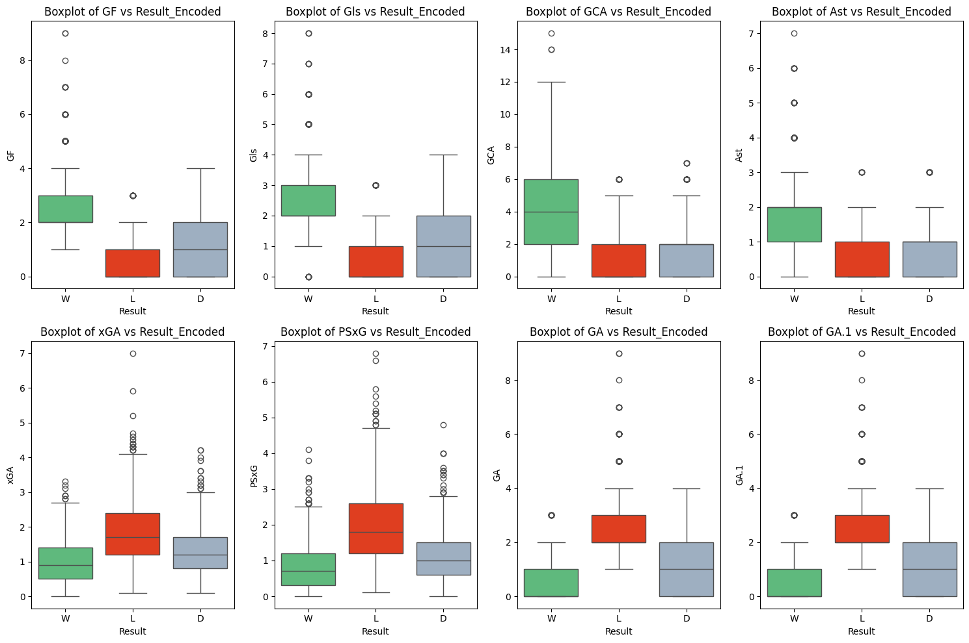
Identifying variables that can most effectively predict the match result

Slide 11
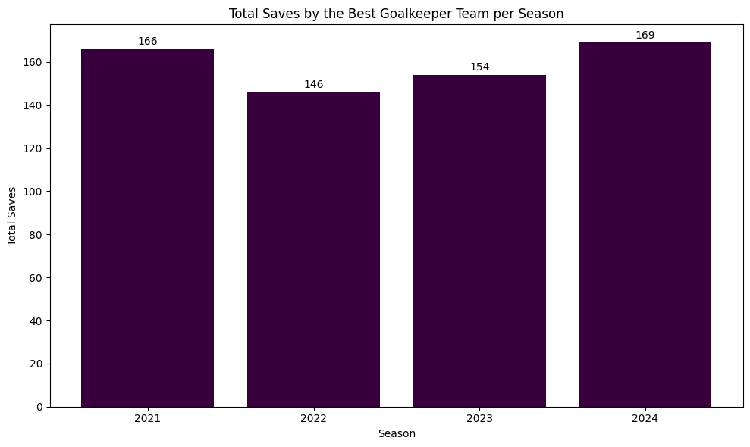

Slide 12

Attacking Strength
A team’s ability to score goals
Metrics like Goals For (GF), Shots (Sh), Shots on Target (SoT), and Expected Goals (xG)
Defensive Strength
Team Strength
A team’s ability to prevent goals by the opponent
Metrics like Goals Against (GA), Expected Goals Against (xGA), and Defensive Actions
Home team advantage
Advantage a team has when playing at its home venue
20.94% of matches result in a home team victory
Recent performance
/12
A team’s current condition in terms of its aggregate performance over recently played matches
Rolling averages capture the current form

Slide 13
/13
Rolling averages
Team | GF_rolling | GA_rolling | Sh_rolling | SoT_rolling
Liverpool | 2.0000 | 1.3333 | 8.0000 | 3.6666
Man. City | 1.6666 | 1.6666 | 5.6666 | 3.6666
Arsenal | 1.0000 | 1.6666 | 7.0000 | 3.6666
Rolling averages capture the current form, which is often a better predictor of near-future performance than season-long averages, especially for dynamic metrics like shots or xG. It accounts for changes like tactical adjustments, player injuries or recoveries and opponent strength in recent matches.

Slide 14
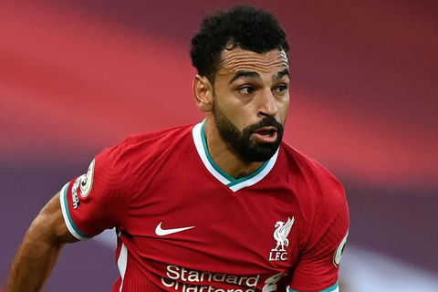



Man. City
vs
Liverpool
Manchester is the home team, while Liverpool is the away team.

Slide 15
Matchweek 13
Team | Venue _code | opp _code | Hour | Day _code | Target | GF _rolling | GA _rolling | Sh _rolling | SoT _rolling | Dist _rolling | FK _rolling | PK _rolling | PKatt_x _rolling
Man. City | 1 | 13 | 12 | 5 | 0 | 4.333 | 1.666 | 18.333 | 8.666 | 16.733 | 1 | 0.666 | 0.666
Liverpool | 0 | 15 | 12 | 5 | 0 | 2.333 | 0.333 | 20.666 | 8 | 18.666 | 0.666 | 0 | 0
Liverpool | Venue _code | opp _code | Hour | Day _code | Target | GF | GA | Sh | SoT | Dist | FK | PK | PKatt_x
MW10 | 1 | 19 | 14 | 6 | 1 | 3 | 0 | 21 | 8 | 19.5 | 2 | 0 | 0
MW11 | 0 | 14 | 16 | 6 | 0 | 1 | 1 | 24 | 6 | 17.5 | 0 | 0 | 0
MW12 | 1 | 3 | 14 | 6 | 1 | 3 | 0 | 17 | 10 | 19 | 0 | 0 | 0
Man. City | Venue _code | opp _code | Hour | Day _code | Target | GF | GA | Sh | SoT | Dist | FK | PK | PKatt_x
MW10 | 0 | 16 | 15 | 6 | 1 | 3 | 0 | 20 | 9 | 17.2 | 2 | 1 | 1
MW11 | 1 | 2 | 15 | 5 | 1 | 6 | 1 | 21 | 8 | 16.4 | 0 | 0 | 0
MW12 | 0 | 6 | 16 | 6 | 0 | 4 | 4 | 14 | 9 | 16.6 | 1 | 1 | 1

Slide 16
Data of 1520 matches was divided into training and test sets. The training set included three seasons (2020/2021 to 2022/2023), comprising a total of 1,140 games, while the test set consisted of the 2023/2024 season, with 380 games.
To identify the optimal classification model, various algorithms with distinct characteristics were tested to determine which one best fits the data.
Model Development
/16

Slide 17
/17
Predictors
Describes each team using features that highlight its strengths and weaknesses relevant to match outcomes.
Model
Training
Rolling averages
Rolling averages are statistical tools that allow us to analyze a team's current attacking and defensive strengths by focusing on its performance metrics over the most recent matches (e.g., the last 3 matches). This approach smoothens short-term fluctuations and highlights recent trends, providing a dynamic assessment of a team's form.

Slide 18
Predicting the match outcome
Date | Team_x | Opponent_x | actual_x | predicted_x | Result_x | Team_y | Opponent_y | actual_y | predicted_y | Result_y
11/25/2023 | Liverpool | Man. City | 0 | 0 | D | Man. City | Liverpool | 0 | 1 | D
8/12/2023 | Arsenal | Nott'ham Forest | 1 | 1 | W | Nott'ham Forest | Arsenal | 0 | 0 | L
8/12/2023 | Aston Villa | Newcastle Utd | 0 | 0 | L | Newcastle Utd | Aston Villa | 1 | 1 | W
9/17/2023 | Chelsea | Aston Villa | 0 | 1 | L | Aston Villa | Chelsea | 1 | 0 | W
Precision scores for all algorithms
Algorithm | Precision
MLP (Neural Network) | 65.28%
Stacking | 62.02%
LightGBM | 59.02%
Gradient Boosting | 57.53%
CatBoost | 56.58%
Random Forest | 55.94%
XGBoost | 55.91%
/18

Slide 19
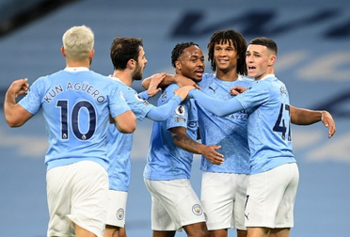
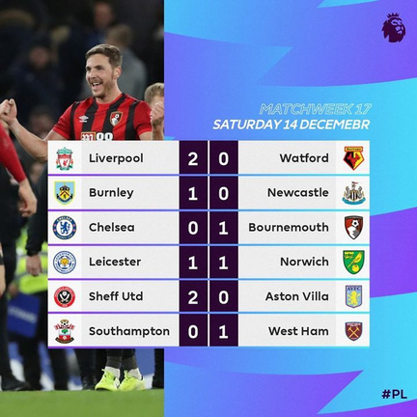
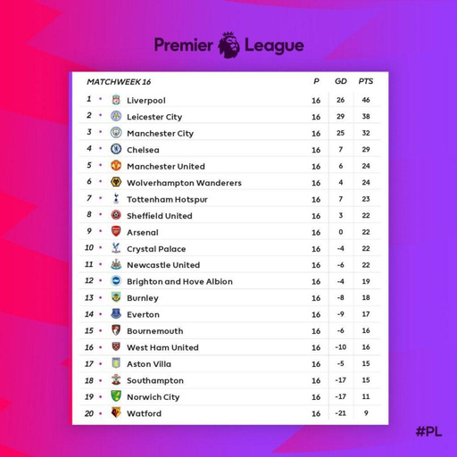
/19
Team performance
Results
And
Discussion
’rolling average’ helps us evaluate a team’s performance and highlights recent trends, providing a dynamic assessment of a team's form.
Match results
outcome of each match can be determined with the matric.
League table
This will give us which team has more probability of wining the league

Slide 20
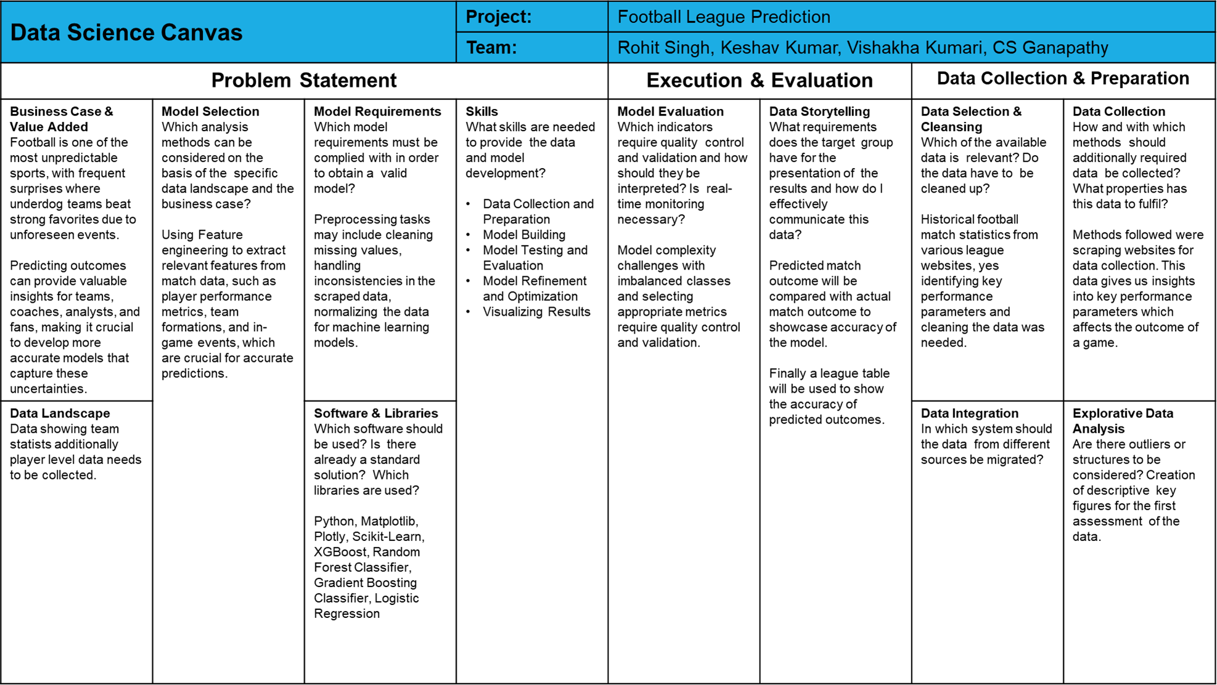

Slide 21
Thank you very much!
https://github.com/rohitlee/Football-League-Prediction

